Slide 1
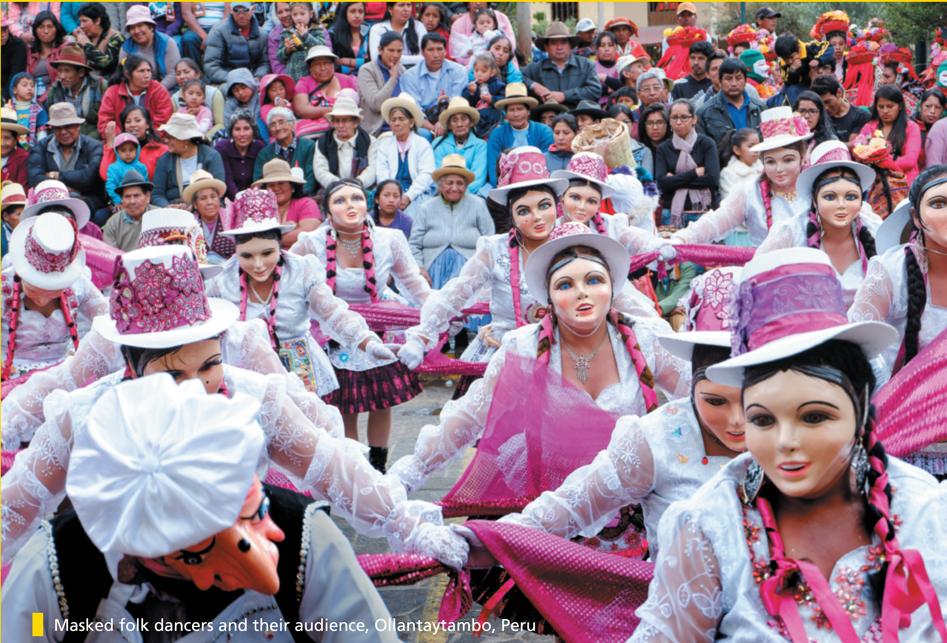

Bringing the world to the classroom and the classroom to life
NGL.CENGAGE.COM/ELT
A PART OF CENGAGE

Slide 2
Who are these celebrities?

Slide 3
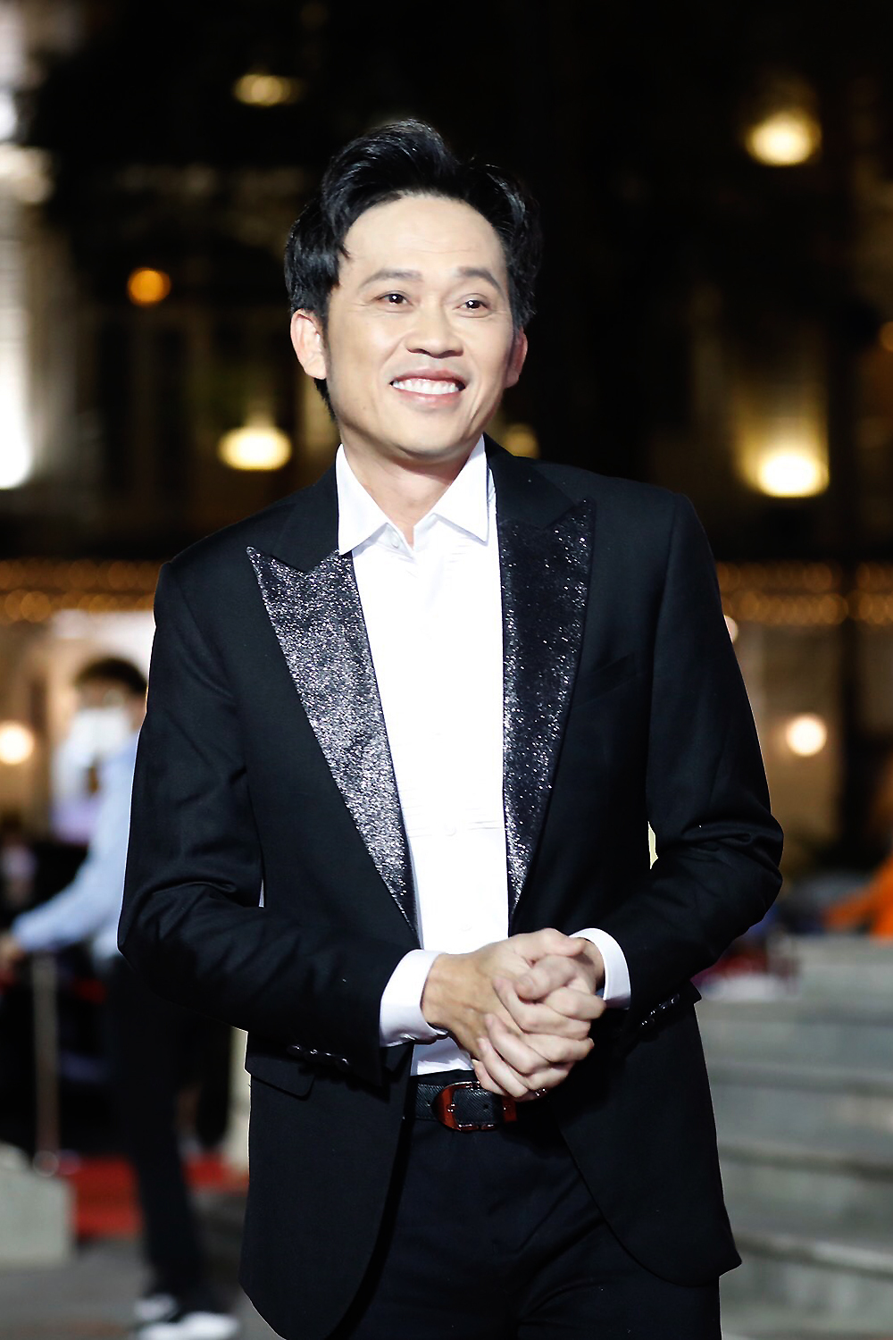

Slide 4


Slide 5
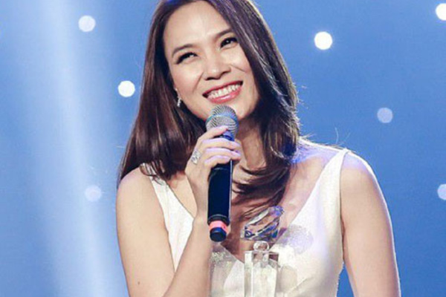

Slide 6
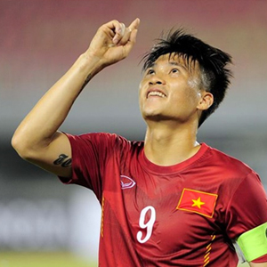

Slide 7
DISCUSSION
Who is your favourite performer or artist?
Tell your partner about this person and why you like him/her.

Slide 8
2e A portrait of an artist
Baz Luhrmann is a film director whose films include Strictly Ballroom, Romeo + Juliet, Moulin Rouge! and Australia.
I have seen every one of his films and in my opinion, Luhrmann’s work just gets better and better. He says that ‘putting on a show’ has always come naturally to him and that Bollywood is his biggest influence. Although he is best-known as a film director, Luhrmann has also directed opera. Consequently, his films are usually exciting, energetic and spectacular. They have had box office success despite being unusual: in Romeo + Juliet the actors speak in verse, in Moulin Rouge! they sing their lines. On the other hand, the epic Australia wasn’t so popular with the critics. Nevertheless, as an ordinary film fan, I thought it was absolutely fantastic. Luhrmann says the high point of his career has been ‘achieving so many of the dreams I had as a kid – from going to the Oscars to getting a letter from Marlon Brando’. To me, his films have the power of dreams. They take you into thrilling, unforgettable worlds.
2e-p. 29

Slide 9

2e A portrait of an artist
Read the review of Baz Luhrmann’s work. What kind of information about Luhrmann is included? Choose the correct options (a–d).
a his influences
b his plans for the future
c his private life
d his work
2e-p. 29

Slide 10
4 Which sentence (a–d) best describes the review? Explain your choice(s).
a It summarizes several different opinions.
b It only talks about negative things.
c It only talks about positive things.
d It’s a personal point of view.
2e-p. 29

Slide 11
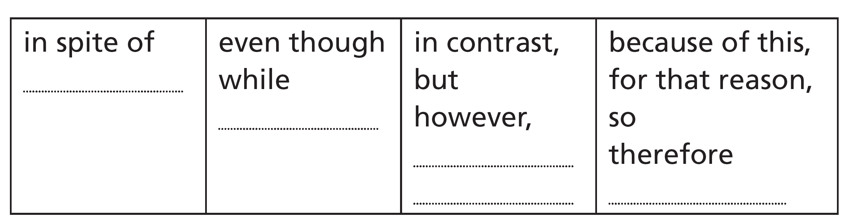
5 Writing skill linking ideas (1)
a Look at the table. Which group of words can replace each highlighted word in the review? Write the words from the review in the table.
b Choose the correct option to complete the sentences.
1 Although / Despite his name is Mark, everyone calls him Baz.
2 Although / Despite working mainly in Australia, he has had international success with his films.
2e-p. 29

Slide 12
c Rewrite the sentences using the words in brackets. Make any changes to verbs and punctuation as necessary.
1 They have had box office success despite being unusual films. (even though)
2 I enjoyed Romeo + Juliet in spite of not understanding all the dialogue. (but)
3 While I love epic films, I didn’t enjoy this one. (Nevertheless)
4 Although they praised Luhrmann’s earlier films, the critics did not like Australia. (In spite of)
5 I’ve seen all of the films, but I haven’t seen any of the operas. (However)
6 His last film was absolutely brilliant. Because of this, I’m looking forward to seeing the next one. (so)
2e-p. 29

Slide 13

6 Write a review of an artist whose work you know and enjoy. First, look at the headings and make notes. You may need to do some research first. Then write about 150 words. Use a variety of adjectives and linkers.
7 Use these questions to check your review.
• Have you used linkers correctly?
• Have you expressed clearly why you like this artist’s work?
8 Read some reviews your classmates have written. Use these questions to check your classmates’ reviews.
• What do you learn about the subject from reading the review?
• Do you agree with the opinions expressed in the review?
2e-p. 29

Slide 14
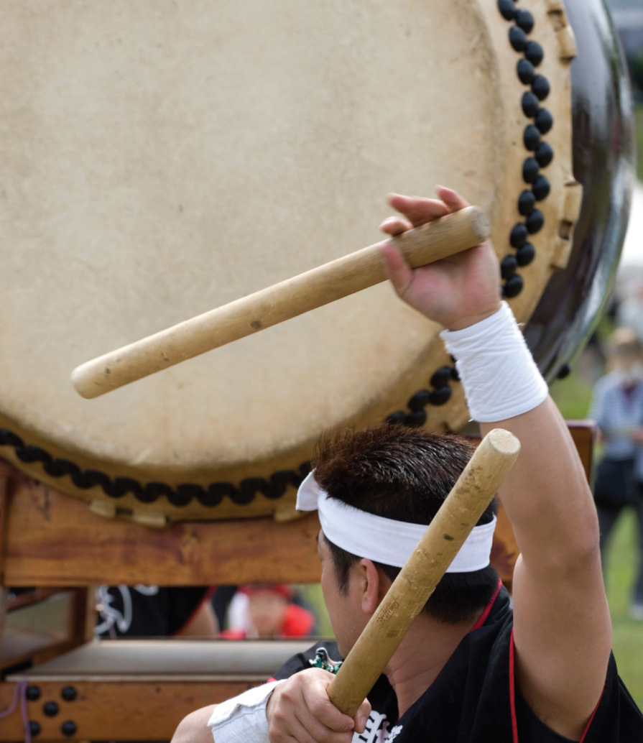
2f Taiko master
Before you watch
1 Look at the photo and the caption. Discuss the questions.
1 What is the man doing?
2 How do you think he feels?
3 What do you think the caption means?
Taiko is an art form that brings
together sound, body and mind.
2f-p. 31

Slide 15
2 Key vocabulary
a Read the sentences. Try to guess the missing words.
1 After the meeting, my __________ was full of ideas.
2 Text messages introduced a new __________ of writing.
3 When you’re driving, __________ can be very dangerous.
4 I like music that has a fast __________.
5 Phil Collins was a popular __________ and singer in the 1980s and 1990s.
6 I’m not feeling well today. I don’t have the __________ to go to class.
b Read the words in bold and their definitions. The words are used in the video. Complete the sentences in Exercise 2a with the words.
a beat (n) a regular sound
b drummer (n) a musician who plays the drums
c energy (n) power and force
d mind (n) your thoughts, feelings, memories, etc.
e style (n) a way of doing something
f tiredness (n) the feeling of being tired
2f-p. 31

Slide 16

While you watch
3 Watch the first part of the video (0.00–0.54). Are the sentences true (T) or false (F)?
1 Japanese warriors used drums 2,000 years ago.
2 The sounds of drums told people where a village boundary was.
3 The sound of drums in Japan has never gone away.
4 Taiko drumming is now popular in San Francisco.
4 Watch the second part of the video (0.55 to the end). Put the events (a–d) in the history of taiko drumming into the correct order.
a About 800 groups started in the United States and Canada.
b Japanese–American communities enjoyed traditional taiko drumming.
c People lost interest in taiko drumming.
d Seiichi Tanaka arrived in the United States.
2f-p. 31

Slide 17
5 Work in pairs. Choose the correct option to complete the sentences about taiko. Then watch the whole video again and check your answers.
1 Japanese warriors used drums to make their enemies attack / fear them.
2 The essence of taiko is that it’s not just people drumming. It’s the unity of the audience / drummers amongst themselves.
3 In San Francisco, the movement of the body / the human voice has now been added to traditional taiko drumming.
4 Taiko drummers sometimes have to play through pain and tiredness / with energy and enjoyment while practising and performing.
5 Seiichi Tanaka is giving North America the chance to enjoy / see the energy and excitement of traditional taiko drumming.
2f-p. 31

Slide 18
Videoscript
Taiko master
Part 1
0.00–0.47 Narrator Two thousand years ago, Japanese warriors used drums to make their enemies fear them. People used to mark village boundaries by how far the sounds of drums travelled.
They even used to do their daily activities to the beat of drums.
Slowly over the years, the sound of the drums went away – until now.
Now, far from Japan in the United States, a new audience is listening to this ancient drum. The art is called ‘taiko’ and it has come from the villages of Japan to the city of San Francisco.
0.48–0.54 Sarita The essence of taiko is that it’s not just people drumming. It’s the unity of the drummers amongst themselves.
Part 2
0.55–1.13 Narrator In San Francisco, the movement of the body has now been added to traditional taiko drumming. It’s now an art form that brings together sound, body and mind. During a performance, the energy of all of these parts goes into the beating of the drums.
1.14–1.24 Seiichi Tanaka Your self and the drum, totally get together. Into the drum ... your self ... and drum come to you ... both mutual.
1.25–1.44 Narrator In the early 1900s, traditional taiko drumming was popular in Japanese-American communities. But, by the mid 1900s, people were losing interest. Then, in 1968, Seiichi Tanaka arrived and brought a new interest and a new style of drumming.

Slide 19
Videoscript
Taiko master
1.45–1.52 Seiichi Tanaka I was just fresh off the boat. So a whole bunch of ‘fresh off the boat’ people get together and play drums.
1.53–2.06 Leigh Tanaka Seiichi is a real pioneer. He’s made a dozen or so groups back in the sixties and seventies into something like 800 groups now spread all over this country and Canada.
2.07–2.19 Seiichi Tanaka All energy from the Mother Nature through your body, come to my body – here ... go through to the drumstick ... BHAM!
2.20–2.32 Narrator Taiko drummers sometimes have to play through pain and tiredness while practising and performing. At that point, some drummers feel that they can really express their feelings and energy.
2.33–2.49 Leigh It’s almost as if you are standing outside of your body kind of looking in. And you hit this point where you’re just completely free.
2.50–3.03 Sarita The essence of Taiko is giving your 110 per cent. You have to always give, because if you don’t give and everyone else is giving, then you’re draining from them.
3.04–3.20 Narrator Here in San Francisco, taiko came from the old world of Japan and was born again. Grand Master Seiichi Tanaka is giving North America the chance to enjoy the energy and excitement of traditional taiko drumming.

Slide 20

After you watch
6 Vocabulary in context
a Watch the clips from the video. Choose the correct meaning of the words and phrases.
b Complete the sentences in your own words. Then work in pairs and compare your sentences.
1 I think I’ve … a dozen or so times.
2 In this school, there are something like … students.
3 I didn’t speak English until … . At that point, I started to learn.
4 I felt better when … went away.
5 Many people in … [place] in … [time] were just fresh off the boat.
2f-p. 31

Slide 21
Videoscript
Taiko master
1 Slowly over the years, the sound of the drums went away – until now.
a disappeared
b got louder
c were played
2 I was just fresh off the boat.
a a good traveller
b a new arrival
c a young man
3 He’s made a dozen or so groups back in the sixties and seventies …
a about twelve
b lots of
c several
4 … into something like 800 groups now spread all over this country and Canada.
a approximately
b at least
c more than
5 At that point, some drummers feel that they can really express their feelings and energy.
a Because of this
b Soon
c Then

Slide 22
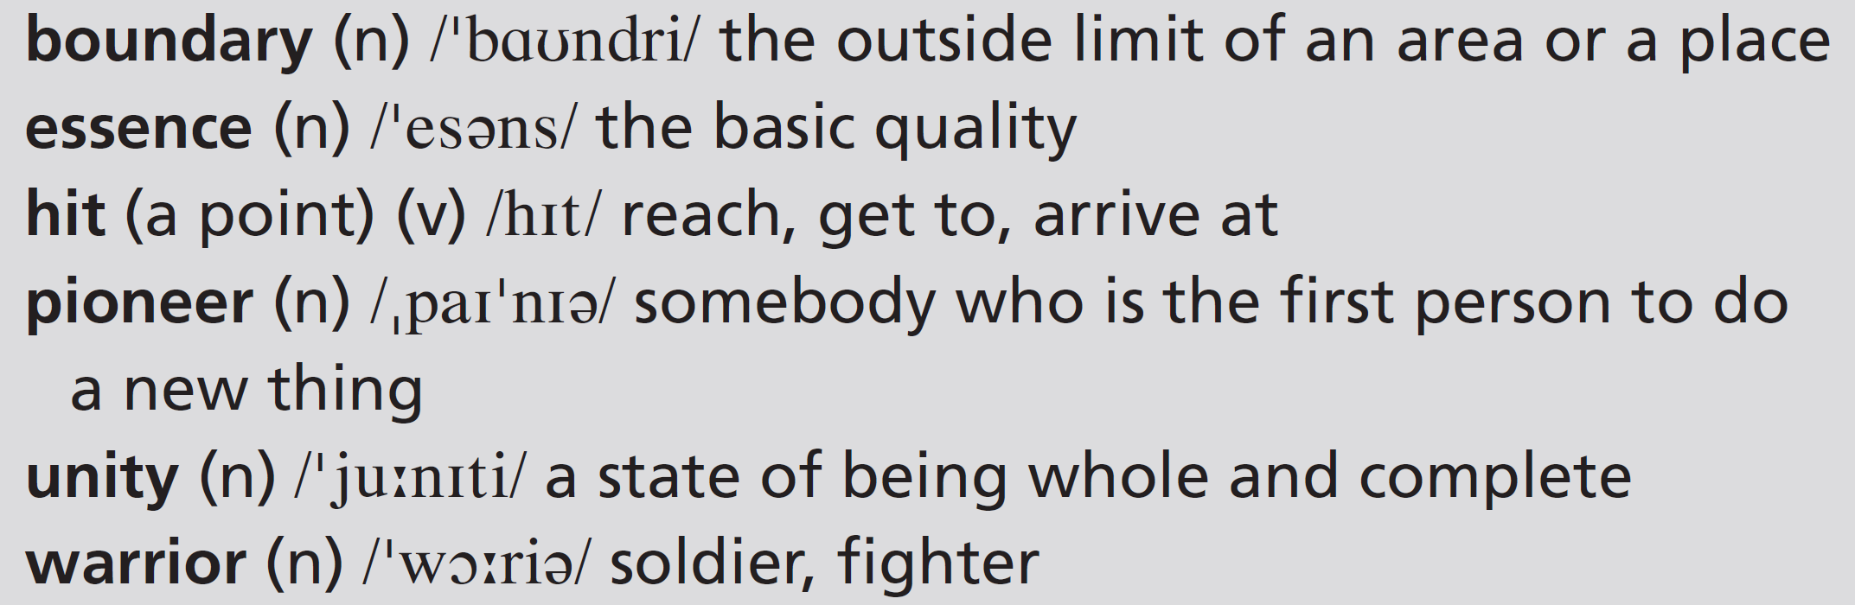
7 Work in pairs. Discuss which art forms (including performances, music, etc.) are or have been traditional in your country or countries. How have they changed in recent decades?
2f-p. 31

Slide 23
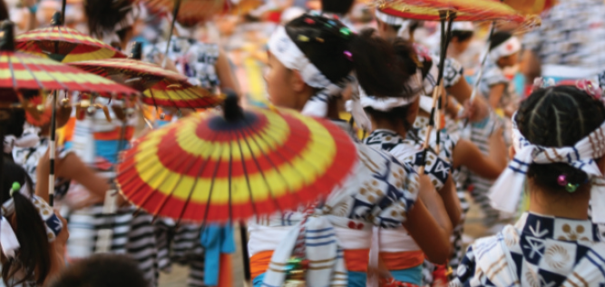
UNIT 2 REVIEW AND MEMORY BOOSTER
Grammar
1 Read part of a blog by a UK visitor to Japan. Find ten places in the blog where words are missing. Complete the blog with these words.
U2 Review-p. 32

Slide 24
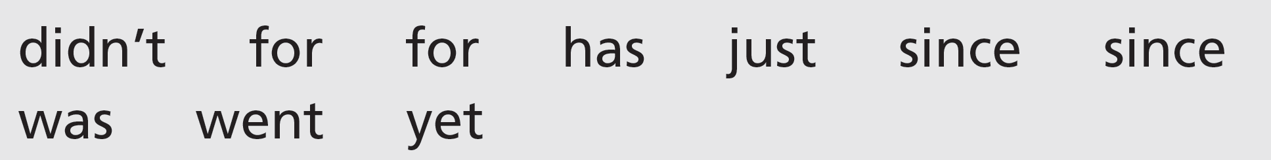
I’ve lived in Japan three months now and I’m really enjoying it. I know any Japanese before I came, but I’ve learned a bit I got here, including the word matsuri, which means ‘festival’. One of my favourite pastimes is going to matsuri. I’ve got home from the Nango summer jazz festival – it was great to sit around in the sunshine listening to brilliant music! Last week we to Tenjin matsuri here in Osaka. It been part of Osaka summer events about a thousand years and some performances have hardly changed then – the traditional kagura music, for example, which I loved. There also an amazing puppet theatre. Tomorrow there’s a big procession of boats on the river. I haven’t been on the river, so I’m really looking forward to that.
U2 Review-p. 32

Slide 25
2 Answer the questions about the blog in Exercise 1.
1 When did the writer learn Japanese?
2 What time of year was it when the writer wrote the blog?
3 What did the writer see at the Tenjin festival?
4 How many times has the writer been on a boat on the river in Osaka?
U2 Review-p. 32

Slide 26

3 Work in pairs. Underline the present perfect simple verbs and circle the past simple verbs in the blog in Exercise 1 and explain why each is used.
Present perfect simple verbs:
I’ve lived: for + a period of time
have learned: the activity started in the past and has an effect on
the present
I’ve just got (home): recent event with an effect on the present, used
with just
has been … for: for + a period of time
have hardly changed since: since + point of time when the activity
started
haven’t been … yet: negative used with yet
Past simple verbs:
I didn’t know: for a finished period of time, i.e. ‘before I came’
I came: it’s clear from the situation when this happened
it was (great): past simple of be – it’s clear from the situation when
this happened
went (to Tenjin Matsuri): we say when the activity happened
I loved: it’s clear from the situation when this happened
There was also: past simple of be – it’s clear from the situation when
this happened
U2 Review-p. 32

Slide 27
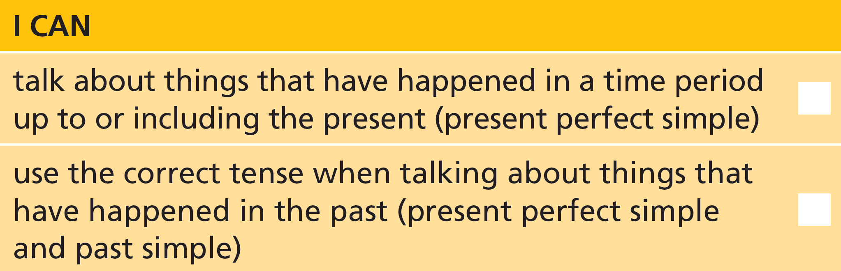
4 Work in pairs. Tell your partner about a festival you have been to.
U2 Review-p. 32

Slide 28
Vocabulary
5 Work in pairs. Which two people are usually involved in these performances? Then choose four types of performer and tell your partner about people you have heard about.
1 FILM: actor, director, magician
2 CONCERT: clown, conductor, musician
3 BALLET: choreographer, comedian, dancer
4 MUSICAL: audience, singer, orchestra
U2 Review-p. 32

Slide 29
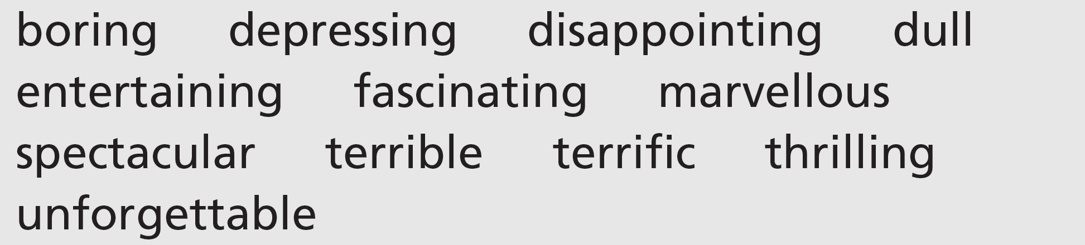
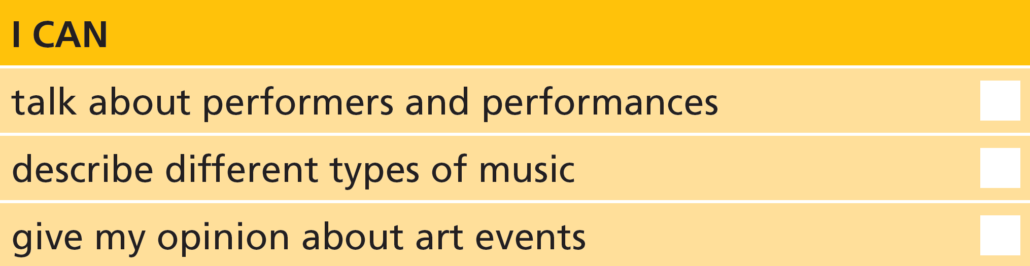
6 Work in groups. In two minutes, write the names of as many ‘hit’ art events (films, books, albums, exhibitions, etc.) as you can. Then discuss the ones you have all heard of. Each person must use all of these words. You can’t use more than two words about one event. Continue until everyone has used all the words at least once.
7 Work in pairs. Describe what kind of music makes you do the following.
U2 Review-p. 32

Slide 30

Real life
8 Work in pairs. Choose the correct option in the questions.
1 A: Do you fancy to go / going out tonight?
2 A: Would you like to see / seeing a movie?
3 A: Do you / Would you like the sound of that?
4 B: Who’s in / on it?
5 B: Who’s it by / for?
6 B: What’s it about / of?
9 Take the roles of A and B in Exercise 8 and act out the conversation, giving answers to the questions and adding more information.
U2 Review-p. 32

